Slide 1
AWS Elastic beanstalk
Simple EC2 deployment and upgrade profiles, for free

Slide 2
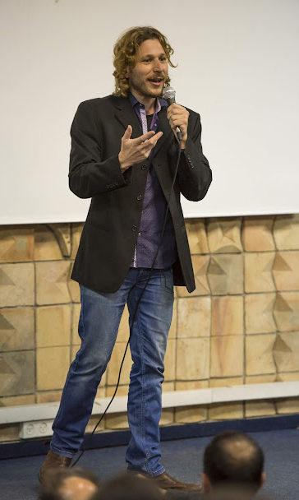
Introducing Mickey
Have been Developing since 1991
Computer Science majoring in information systems
MBA majoring in entrepreneurship
Systems/Software/Solutions architect for the past 10 years
I love training, teaching and mentoring developers
I am married with 2 beautiful kids and a dog
I also love 4x4’ing and can talk hours about this stuff

Slide 3

Meet Jake
Jake is currently a single developer, but is hoping to add a few teammates soon

Slide 4

The Idea
Jake is working on a prototyping webapp.

Slide 5

A video transcription marketplace
users transcribe videos in English
Users select a video from the list, and transcribe the file locally
or upload a transcribed file to the server.
Later we’ll add AI and other cool stuff

Slide 6

Requirements
The webapp will include a database and a frontend application
3 environments, dev, test and prod
Hopefully blue/green or other a | b testing as well
other backend services will be added
High Resiliency, High Availability and Cost efficiency – a must

Slide 7

What would Jake need to setup
Source code

Slide 8


What would Jake need to setup
Auto Scaling
DEPLOY
BUILD
Physical servers
EC2 Instance(s)
YOUR APP
YOUR APP
CI / CD / manual
DEPLOY new version with Rollback and minimal downtime
Source code
Load balancer
Health and logs
Health and logs
Sms/email alerts
metrics
metrics
Language runtime
Language runtime
Cloudwatch
OS
OS
Cloud Formation
Hypervisor

Slide 9
AWS Elastic beanstalk to the rescue
VPC
Managed Auto Scaling
DEPLOY push new versions with Rollback and minimal downtime
BUILD
Physical servers
Managed Load balancer
EC2 Instance(s)
YOUR APP
YOUR APP
CI / CD manual/automated
Sms/email alerts
Health and logs
Health and logs
Source code
Cloudwatch
metrics
metrics
Language runtime
Language runtime
Elastic beanstalk monitoring and management console (FREE)
Elastic beanstalk engine (FREE)
OS
OS
Cloud Formation
Hypervisor

Slide 10


3 Environments each running different versions
DEV env
Push new version
PROD env
TEST env

Slide 11


DEMO TIME
Create a new elastic beanstalk application in under 30 seconds work
Add 3 environments dev, test and prod
Dev will have 1 instance
Test will have 2 instances
And prod will have min=1 instances max=100
We will create 3 regions of this prod
Availability:
- 1 EC2 concurrent capacity = 3,000 requests
- 100 EC2 can handle ~300,000 requests, enough to handle the Christmas traffic
Notes:
./var/app/current/application.py

Slide 12
Simply Deploy and Maintain environments
To deploy a new webapp
All SG Firewall rules pre configured
Autoscaling pre-configured incl ASG creation
ELB pre configured (and free)
Very basic options are required, others in advanced
Elastic beanstalk
cfg
Cloud Formation Engine
Each environment can be in a different AvailabilityZone and region at your discretion
AWS resources provisioning and deployment

Slide 13
Easy out-of-the-box push new versions of your app
All at once – fastest with downtime - terminates machines and updates them
Rolling (with batches) - terminates <batch size>
Rolling with additional batches – adds <batch size>
Immutable – creates temporary autoscaling group, twice the instances, and after health-check, terminates them
Traffic splitting – blue/green timed deployment
Included in the box: new version rollback, multi region Autoscaling for High Availability and Resiliency with health

Slide 14
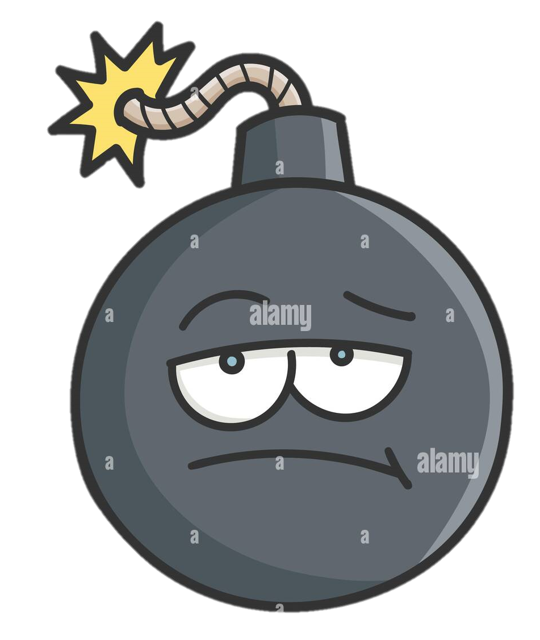
DEMO TIME
Checkup on our prod environment
Update using blue/green 10/90 split
Connect to the EC2 instances interactively
Notes:
./var/app/current/application.py

Slide 15
All at once
ASG
ASG
ASG
v1
v1
v2
v1
v1
v2
v1
v1
v2

Slide 16
Rolling
ASG
ASG
ASG
ASG
ASG
v2
v1
v1
v1
v2
v2
v1
v2
v2
v2
v2
v1
v2
v2
v2
Batch size = 2

Slide 17
Rolling with additional batches
X
Temp ASG
Temp ASG
Temp ASG
Temp ASG
v1
v1
v2
v2
v2
v1
v2
v2
v2
ASG
ASG
ASG
ASG
ASG
v2
v1
v1
v2
v2
v2
v1
v2
v2
v2
v2
v1
v2
v2
v2
Batch size = 2

Slide 18
Immutable
ASG
ASG
ASG
ASG
ASG
v2
X
v2
v2
v2
v2
v2
v2
v2
v2
v2
v2
v2
v2
v2
v2
ASG
ASG
ASG
v1
v1
v1
v1
v2
v2
v2
v1
v1
v1
v1
v2
v2
v2
v2
v2
v2
v1
v1
v1
v1

Slide 19
Traffic splitting (Blue/Green) with timer
Environment GREEN
ASG
v2
v2
Application Load balancer
v2
Timer
X
Environment BLUE
ASG
ASG
v1
v1
v1
v1
v1
v1

Slide 20
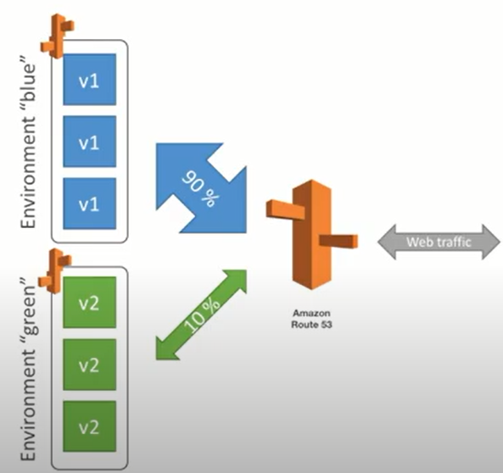
Easily create and maintain blue/green

Slide 21
Let’s recap quickly…
Managed Auto Scaling
DEPLOY push new versions with Rollback and minimal downtime
BUILD
Physical servers
Managed Load balancer
EC2 Instance(s)
YOUR APP
YOUR APP
CI / CD manual/automated
Sms/email alerts
Health and logs
Health and logs
Source code
Cloudwatch
metrics
metrics
Language runtime
Language runtime
Elastic beanstalk monitoring and management console (FREE)
Elastic beanstalk engine (FREE)
OS
OS
Cloud Formation
Hypervisor

Slide 22
When the app grows to multiple services?

Slide 23
Gradual shift to containers
One deployment docker-compose file per instance
Instance will run multiple containers (using docker engine)
All containers run on all instances
scale by instance only, not by container

Slide 24
Running containers
Managed Auto Scaling
DEPLOY push new versions with Rollback and minimal downtime
BUILD
Physical servers
Managed Load balancer
EC2 Instance(s)
service1
webAPP
service1
webAPP
CI / CD manual/automated
Sms/email alerts
Health and logs
Health and logs
Health and logs
Health and logs
Source code
metrics
metrics
metrics
metrics
Cloudwatch
Language runtime
Language runtime
Language runtime
Language runtime
Container engine
Container engine
Elastic beanstalk monitoring and management console (FREE)
Elastic beanstalk engine (FREE)
OS
OS
Cloud Formation
Hypervisor

Slide 25
Where to go from here
AWS services for containers
Elastic Container Service
Fargate
App runner

Slide 26

Questions?

Slide 27

Thank you

Slide 28
Container world
AutoScaling
DEPLOY
BUILD
Physical servers
EC2 Instance(s)
Containers
CI / CD
Source code
YOUR APP
YOUR APP
Load balancer
Language runtime
Language runtime
Container orchestration agent
OS
Container orchestration
Hypervisor

